Slide 1

Decision Structures
Prepared and presented by - Naomi Padmore

Slide 2
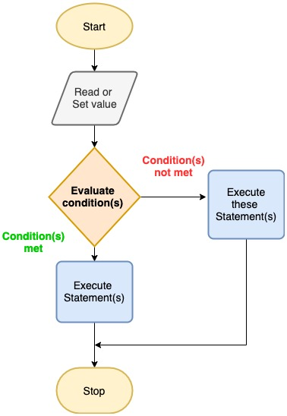
Decision Structures
Allows us to make more complex programs; programs with multiple paths of execution
Notes:
It allows us to make more complex programs; able to have multiple paths of execution

Slide 3
Cases
Odd or Even Number program
Amusement Park Ticketing program
GPA Calculator program

Slide 4
Case 1
Odd or Even Number program

Slide 5
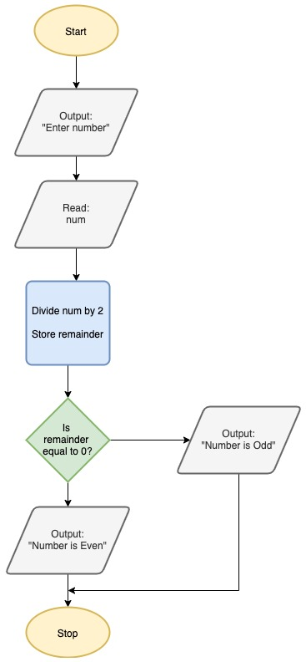
Case 1 – Odd or Even Numbers

Slide 6
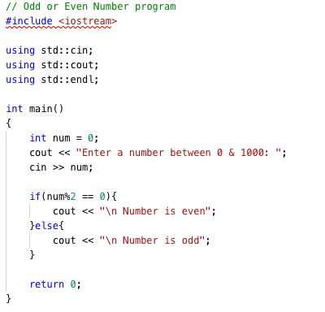
If statements
if (condition met) {
statement;
}else{
next_statement;
}

Slide 7
Case 2
Amusement Park Ticketing program

Slide 8
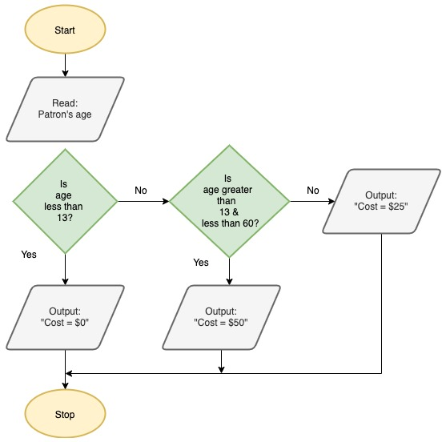
Case 2 – Determining Price of Ticket

Slide 9
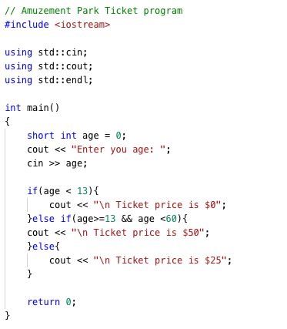
If statements Cont’d
if (condition) {
statement;
}else if (condition) {
next_statement;
}else{
another_statement;
}

Slide 10
If statements Cont’d
#include<iostream>
int main() {
int large = 2,larger = 4;
if (large < larger) {
std::cout<<large<<"is less than"<<larger<<std::endl;
large = 10; //note the change in variable value
}
else if (large > larger) {
std::cout<<large<<"is greater than"<<larger<<std::endl;
}
return 0;
}
if (condition) {
statement;
}else (condition) {
next_statement;
}
vs
if (condition) {
statement;
}if (condition) {
next_statement;
}

Slide 11
If statements Cont’d
#include<iostream>
int main() {
int large = 2,larger = 4;
if (large < larger) {
std::cout<<large<<"is less than"<<larger<<std::endl;
large = 10; //note the change in variable value
}
if (large > larger) {//if instead of if else
std::cout<<large<<"is greater than"<<larger<<std::endl;
}
return 0;
}
if (condition) {
statement;
}else (condition) {
next_statement;
}
vs
if (condition) {
statement;
}if (condition) {
next_statement;
}

Slide 12


If statements Cont’d
Using if-else
Using if only
If-else exits the entire if block as soon as one condition evaluates to true
Using ifs only is effectively a new, separate control flow and not part of the previous if statement (unless if is nested)
if (condition) {
statement;
}else (condition) {
next_statement;
}
vs
if (condition) {
statement;
}if (condition) {
next_statement;
}

Slide 13
Case 3
GPA Calculator Program

Slide 14
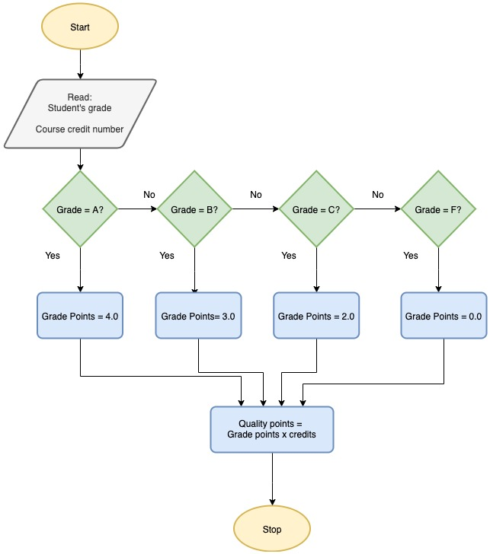
Case 3 – Calculating Quality Points

Slide 15
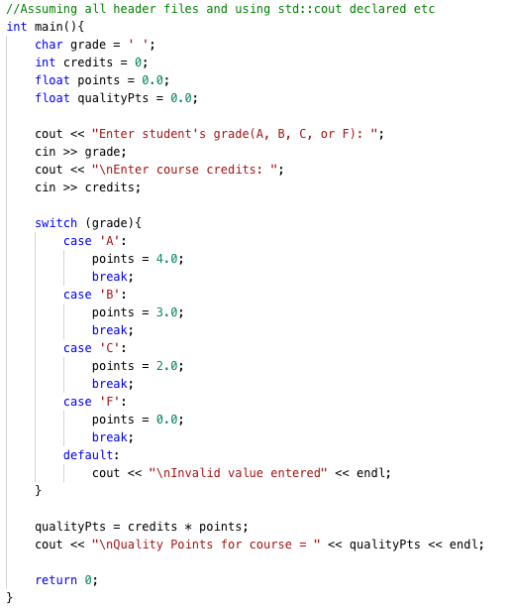
Switch Case Statement
switch (variable){
case ’first_value’:
statement;
break;
case ’second_value’:
statement;
break;
default:
statement[
}

Slide 16
That’s All

